Slide 1
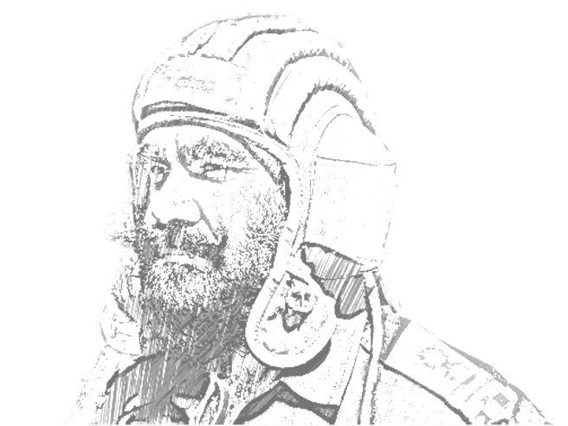

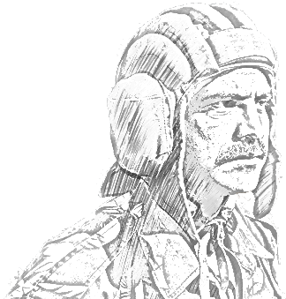

SCHOOL OF TECH TRG
ELECTRONICS WING

Slide 2
INTRODUCTION

Slide 3
AIM
Iss sabak ka aim communication layout of an armd regt ke bare mein class ko jankari hasil karana hai.

Slide 4
SCOPE
Bhag No – I Aambayaan.
Bhag No – II Comn Layout.
Bhag No – III Regt Freq Procedure.
Bhag No – IV Instructions.
Bhag No – V Recce Tp Composition & Tasks.
▪ Composition. ▪ Recce Tp Veh Layout & Comn ▪ Veh Layout. ▪ Communication.
Bhag No – VI Rover layout

Slide 5
BHAG NO – I AAMBAYAAN

Slide 6
PRINCIPLES
➢ Tactical. Jarurat ke mutabiq istemal hone wale level per comn range .
(i) Tp- 2KM ya isse jaada.
  (ii) Sqn- 8km ya isse jiada.
  (iii) Regt – 16 km ya jiada.
  ➢ Range Wastage. Exact range koi nahi bata sakta lekin jitna hamari regt ka falav hai usse18-20% comn range jiada rakha jata hai.
  ➢ Security. Range itana jiada nahi hona chahie ki dushman usmein intercept kar saken.

Slide 7
Links. Regt mein command and control ko behtar banane ke liye niman link mein banta gaya hai.
➢ Forward link. Jis per command ho.
➢ Rear link. Jiski command mein ho.
➢ Misc link. Jo sath ho.

Slide 8
RADIO NET
Radio Net. Links par adharit Regt mein char prakar ke nets hote hain.
  ➢ A NET – RHQ TO SHQ & MISC STN.
  ➢ B NET – SHQ TO TP LDRS & MISC STN.
  ➢ C NET – TP LDRS TO PT TK & MISC STN.
  ➢ MISC NET – RECCE TP , A1 ECH A2 ECH,RSO, TO, ITYADI.

Slide 9
BHAG NO – II COMN LAYOUT

Slide 10
ECH LONS
➢ Ek Armd Regt mein Vehs:-
➢ In Peace.
▪ Command Tk - 03
▪ Control Tk - 06
▪ APC - 06 (02 x Ambulance,
03 x FRT, 01x Rover)
▪ Gun Tks - 36
▪ Jeep /Gypsy - 28
▪ 2.5 Ton - 02
▪ ARV - 03
➢ In War or Trg. Larai ke dauraan command aur control ki aasaani ke liye zaruri saamaan jaise FOL, Amn aur Ration pahunchaane ke liye Regt ko char echlon mein baanta gaya hai:-

Slide 11
ECH LONS
➢ F- ECH - Fighting - (All AFV aur rovers, recce tp , kai ek baar 1st AID (Ambulance) veh and recovery.)
Note:- Iske ilawa dependent on unit Cdr
➢ A1- ECH - (Cdr - HQ Sqn 2IC) Kuchh Adm veh, Fol, Amn jaldi se F- Ech ko pahuchane ke liye.
➢ A2 – ECH- (Cdr – OC HQ Sqn ) Regt ke reserve Fol & Amn le jane ke liye. Regt aur Sqn office veh aur LRW ki veh is Ech mein hoti hai.
➢ B-ECH - (01XJCO / NCO under Regt QM) Regt ke heavy baggage, kits, store aur reserve ration ko le jane ke liye hoti hai.
Note:- Jarurat padne per badli bhi ja sakti hai.

Slide 12
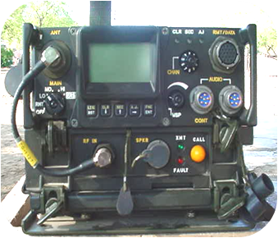
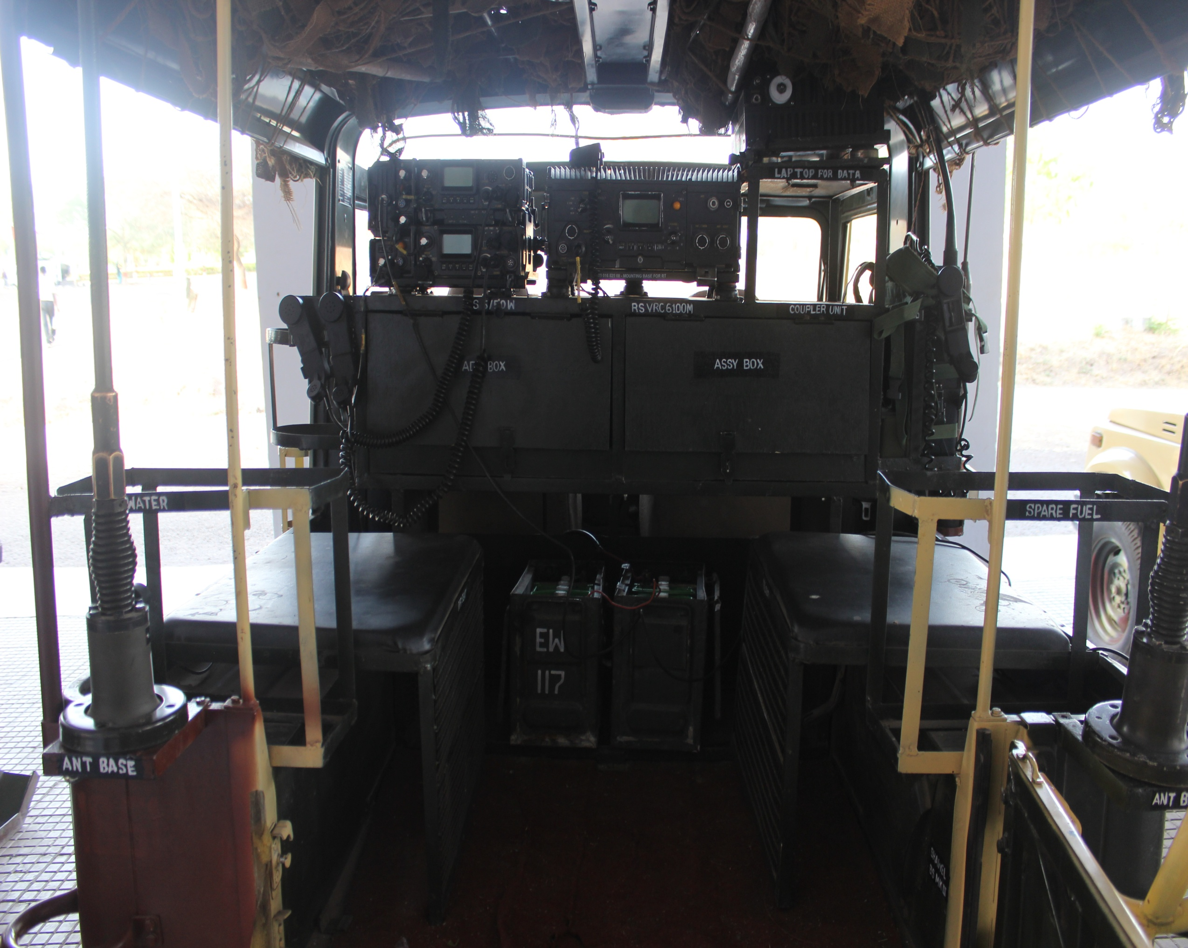
➢ Radio Sets ka Distr
▪ A Set- RS CNR900M 5/50 W
▪ B Set- RS CNR900M 50 W ▪ C Set - RS CNR 900M 50/50W
▪ D Set- RS VRC 6100M (HF)
➢ Radio Freq Proc
▪ Regt Freq Nets
▪ Sqn Freq Nets

Slide 13
➢ Tp fwd link.
▪ Tp rear link.
▪ Sqn fwd link.
▪ Sqn rear link.
▪ Sqn misc link.
▪ Regt fwd links.
▪ Regt rear/G link - B 1A link - CO to Bde Cdr.
B1 link - Adjt to GSO1 (BM)
▪ Regt Q link B21 maint by - QM to AQ.
▪ Regt T link B24 " - TO to Bde EME
▪ Regt Misc link.
▪ IC Tp

Slide 14
Authorisation of Radio Sets in Sqn.
Radio Set CNR 900M 5/50W (AFV) 14 x 1 = 14
Radio Set CNR 900M 50W (AFV) = 03
▪ OC tank = 01
▪ SQN 2IC = 01
▪ ARV = 01
Radio Set CNR 900M 5/50W TG = 01
▪ OC Rovers = 01
Radio Set CNR 900M 50W TG (Stand Alone ) = 02
▪ SBJ = 01
▪ IRG = 01
-----------------------------------------------------------------------
TOTAL = 20

Slide 15
Authorisation of Radio Sets.
Radio Set CNR 900M 5/50W (AFV) 14 x 3 = 42
Radio Set CNR 900M 50/50W (AFV) 01 X 03 = 03
Radio Set CNR 900M 50W (AFV) = 09
OC tank = 03
Sqn 2IC = 03
▪ ARV = 03
Radio Set 100W (AFV) = 03
CO TK, 2IC TK , ADJT TK
Radio Set CNR 900M 5/50W TG = 07
▪ OC Rovers = 03
▪ Recce Tp Ldr = 01
▪ QM = 01
▪ TO = 01
▪ OC HQ Sqn = 01
Radio Set CNR 900M 50/50W TG = 03
▪ CO Rover = 01
▪ 2IC Rover = 01
▪ Comn Veh = 01

Slide 16
Authorisation of Radio Sets.
Radio Set CNR 900M 50W TG (Stand Alone ) = 15
▪ SBJ = 03
▪ IRG / OC HQ = 03
▪ Recce Tp = 06
▪ OC LRW = 01
▪ 2IC HQ = 01
▪ RMO = 01
Radio Set VRC 6100M 100W TG = 02
▪ CO Rover = 01
▪ Comn Veh = 01
-----------------------------------------------------------------------------
TOTAL = 84
Manpack = 04
▪ Commd Tk = 02
▪ CO Rover = 01
▪ 2IC Rover = 01

Slide 17
1A
1B
2A
2B
3A
3B
4A
4B
5/50W
5/50W
5/50W
5/50W
5/50W
5/50W
5/50W
5/50W
B1
B2
B3
B4
5/50W
5/50W
5/50W
5/50W
B15
B20
B40
B42
5/50W
50W
5/50W,50W
50W
ASQN
B SQN
C SQN
5/50W, 50W
5/50W, 50W
5/50W, 50W
24
25
50/50W,100W
CO TANK
50/50W,100W
50/50W,100W
COMN VEH
CO ROVER
50/50W,100W
2IC ROVER
50/50W,100W
50/50W
22A
22C
22E
QM
TO
OC HQ
IRG x03
22
50W
50W
50W
5/50W
5/50W
5/50W
50W
5/50W
22B
22D
22F
OC LRW
RMO
2IC HQ
50W
50W
50W
50W
50W
50W
LEGEND:-
RED = 5/50 49 BLUE = 100W 05 TOTAL=84 GRAND TOTAL = 88
GREEN = 50W 24 BROWN 50/50 = 06 MP =04

Slide 18
BHAG NO – III REGT FREQ PROCEDURE

Slide 19
REGT FREQ AUR SQN FREQ
Regt Freq (RF) Net. Poori Regt ek hi freq par ho. Jab iss freq par kaam ho raha ho toh kisi Sqn yaa Sqns ko operation ki situation ke mutaabiq sqn freq par bhi change karaaya jaa sakta hai. Lekin baaqi Regt, Regt freq par hi kaam karegi.
Sqn Freq (SF) Net. Tamaam Sqns apni-apni alloted freq par kaam karte hain, aur sqn 2IC rear link ka kaam karta hai. Iske alaawa Sqn commandr ka dusra set bhi CO ke saath comn ke liye net mein rahta hai.

Slide 20
REGT FREQ KE FAIDE
Tamam regt ke radio set user ko regt ke halat ke bare mein pata rahta hai.
CO point tk tak order pass kar sakta hai.
Time ki bachat hai.
Galat order par amal hone par roka ja sakta hai.
Sqn Cdr ko CO ke orders repeat nahin karne parte.
Order aur info teji se pass hote hain.
Re-action tej hai.

Slide 21
REGT FREQ KE NUQSAN
Bara net hone ki wajah se jamming ziada hai.
Command aur control muskil hai.
Sub unit Cdr ko net par bolne ka mauqa nahin milega jis se zaruri msg delay ho jate hain.
Security kam hai.
Net ko kamyab banane ke liye unche darje ki training aur discipline ki zarurat hoti hai.

Slide 22
SQN FREQ KE FAIDE
Command aur control asan hai.
Kam stn hone ki wajah se jamming kam hai.
Comn range adhik milta hai kiyonki sqn rear link se (close) milap rakhta hai.
Sub unit Cdr ko set par bolne ka mauqa milta hai.
Security adhik hai kiyonki tamam Sqn alag-alag net aur freq par hain.

Slide 23
SQN FREQ KE NUQSAN
Sqn ke set user ko dusri sub ya sub-sub unit ke action ke bare mein pata nahin hota.
Channel lamba hone ki wajah se higher Cdr ko orders aur info pass karne mein jaida samay lagta hai.
Sqn Cdr ko CO ke order repeat karne parte hain.
CO point tk se sidhe bat nahin kar sakta.

Slide 24
COMN WITH HIGHER FMN
Comn with Higher Fmn.
▪ B1 link mein (G rear link) Adjt aur GSO1 (BM) main out stn hote hain. Iss par CO, 2 IC call karte waqt Regt code sign ke saath fig affixes istemaal karte hain.
▪ B21 net mein (Q rear link) QM, AQ ke saath communication mein rahta hai. Alag code sign milata hai.
▪ B24 net (T rear link) TO, Bde EME ke saath net rahta hai. (OC LRW bhi ho sakta hai).

Slide 25
BHAG NO – IV INSTRUCTION

Slide 26
INSTRUCTION
Kam se kam bolo, rear sqn khud be khud air ko khaali rakhen taaki leading sqn ko msg paas karne mein koi preshaani naa ho.
Ziada se ziada transmission out se khatam hon.
Msg offer, time sig, sig strength aadi mat puchho taaki time ki bachat ho.
Set par mat so jaao. Listening watch hoshiari se karo, chaahe aap ke liye koi bhi transmission naa ho.
Fig affixes 73, 62, 51 aur 50 ka istemaal karte waqt "I say again" ka istemaal karna chahiye.
Agar comn kharaab hai toh ending sig ka bhi istemaal karo.

Slide 27
BHAG NO – V RECCE TP COMPOSITION & TASKS

Slide 28
RECCE TP COMPOSITION & TASKS
➢ Recee Troop Composition & Tasks. Ek Armoured Regt mein Recce TP Regt ke aankh aur kaan jaise hote hain. Larai aur exercise ke dauraan bagair Recce Tp ke koi bhi Regt kaamyabi haasil nahi kar sakte hain. Isliye ek Opr hone ke naate, Recce Tp ke baare mein jayada se jayada jaankaari honi chahiye.
➢ Man Power.
▪ JCOs - 02
▪ DFR - 05
▪ OR - 15

Slide 29
EQPT
➢ Eqpt.
▪ Gypsy/M&M - 07
▪ Radio Set CNR 900M - 07 (1X5/50W,6X50W)
▪ Pistol - 02
▪ INSAS - 20
▪ MAG 5A/6A/2A - 07
▪ Signal Pistol - 01
▪ Binocular - 07
▪ Map - 07
▪ Compass - 07
▪ PNVD - 07
▪ GPS - 03
▪ BFSR(SR) - 03

Slide 30
EQPT
(RECCE TP)
TL SEC (01,03)
(1XGYPSY/Jeep)
A Sec B Sec C Sec
DFR – 02 JCO – 01 DFR – 02
ORs - 04 DFR - 01 ORs – 04
ORs - 04 Gypsy/Jeep – 02 Gypsy/Jeep – 02 Gypsy/Jeep - 02

Slide 31
TASKS
➢ Tasks
▪ Silence battle recce.
▪ Route , AIC , RV, FUP,Marking.
▪ Traffic Control.
▪ Night Navigation.
▪ Step up station ka kaam.
▪ Helipad & DZ Marking.
▪ Casualty Evacuate.
▪ Terrain & Topographical recce.
▪ Obsn screen Obst, Delaying posn or main defs kai sath.
▪ EW (Type & strength of Enemy).
▪ Surviellence.
▪ FUP aur RV ke liye suitable jagah ki talash.
▪ Obstical crossing point ki talash.

Slide 32
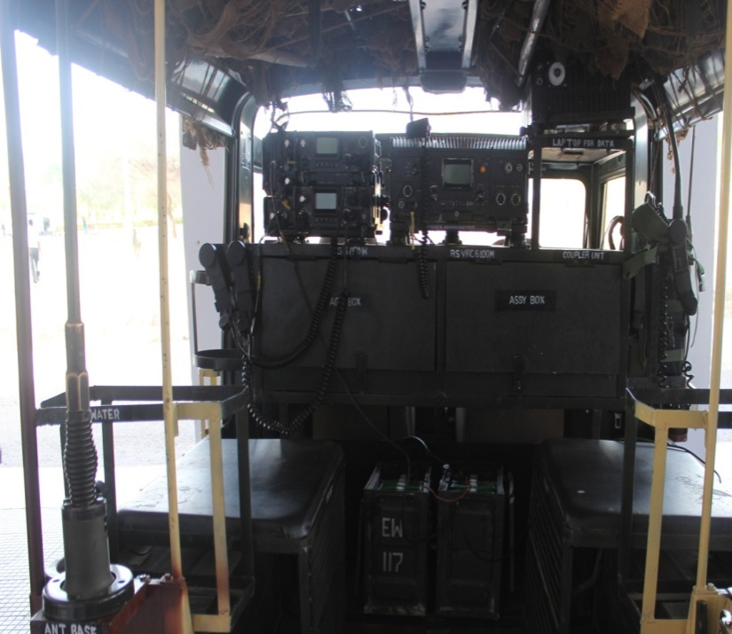
VEHICLE LAYOUT
➢ Vehicle Layout. Recce TP Veh ki kitting iss prakaar hai.
▪ Air Compressor.
▪ Toe Rope.
▪ Alternator/Dynamo.
▪ Extra FOL Tank.
▪ Map.
▪ Binocular.
▪ Compass.
▪ GPS.
▪ Marking Poles.
▪ LED Arrow for marking routes.
▪ LED boards (AVWA,IN,OUT,RV,FUP).
▪ Beacon Lights.
▪ Extra Water Tank/Jerican/Muel Tanks.

Slide 33
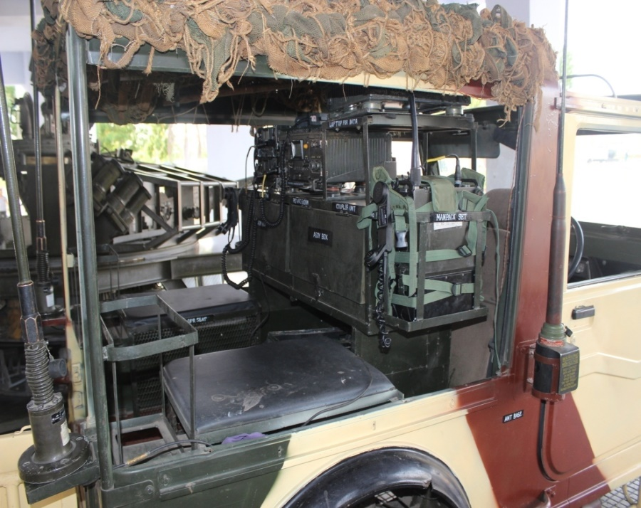
VEHICLE LAYOUT
▪ Axis Pick.
▪ Showel GS.
▪ Hot Case.
▪ Net Cemoflage.
▪ Dry ration for 3 days.
▪ Maga 5A/6A/2A.
▪ Crew bedding.
▪ White tape for marking (VSL,BLT).
▪ Load Table.

Slide 34
COMMUNICATION
➢ Communication
▪ As a step up stn.
▪ As a EW det.
▪ Flank guard/Flank protection.
▪ Advance guard.
▪ Rear Guard.

Slide 35
BHAG NO VI ROVER LAYOUT

Slide 36
TYPES OF ROVER
➢ Types of Rover.
▪ CG Cdr Rover. Yeh ek Regt ek hi hota hai. Yeh Commanding oficer islemaal karta hai.
▪ CT Cdr Rover. Yeh Regt mein 3 hota hai. Tamam sabre Sqn OC istemaal karta hai.
▪ Comn Veh/Adjt Rover. Yeh Regt ka Adjt istemaal karta hai. Is ke liye ek 2.5 Ton veh auth hai.
▪ Regt 2IC Rover. Yeh Regt 2IC istemaal karta hai.

Slide 37
EQPT AUTH IN ROVER
➢ CG Cdr Rover.
▪ Gypsy - 01
▪ RS VRC 6100M - 01
▪ RS CNR 50/50W - 01
▪ Operational area map - 01
▪ GPS - 01
▪ Compass - 01
▪ Binocular - 01
▪ Sig Pistol - 01

Slide 38
EQPT AUTH IN ROVER
➢ CT Cdr Rover.
▪ Gypsy - 01
▪ RS CNR 5/50W - 01
▪ RS CNR 50W - 01
▪ Operational area map - 01
▪ GPS - 01
▪ Compass - 01
▪ Binocular - 01

Slide 39
EQPT AUTH IN ROVER
➢ Comn veh/Adjt Rover.
▪ 2.5 Ton - 01
▪ VRC 6100M - 01
▪ RS CNR 50/50W - 01
▪ Operational area Enlargement - 01
▪ GPS - 01
▪ Compass - 01
▪ Binocular - 01

Slide 40
EQPT AUTH IN ROVER
➢ 2IC Rover.
▪ Gypsy - 01
▪ RS CNR 50/50W - 01
▪ Operational area map - 01
▪ GPS - 01
▪ Compass - 01
▪ Binocular - 01

Slide 41
Poore sabaq mein koi shaq?
Ek Armd Regt mein CNR 900M 5/50W kitne radio set hote hai?

Slide 42
COMN LAYOUT OF AN ARMD REGT

Slide 43
SCOPE
Bhag No – I Aambayaan.
Bhag No – II Comn Layout.
Bhag No – III Regt Freq Procedure.
Bhag No – IV Instructions.
Bhag No – V Recce Tp Composition & Tasks.
▪ Composition. ▪ Recce Tp Veh Layout & Comn ▪ Veh Layout. ▪ Communication.
Bhag No – VI Rover layout

Slide 44
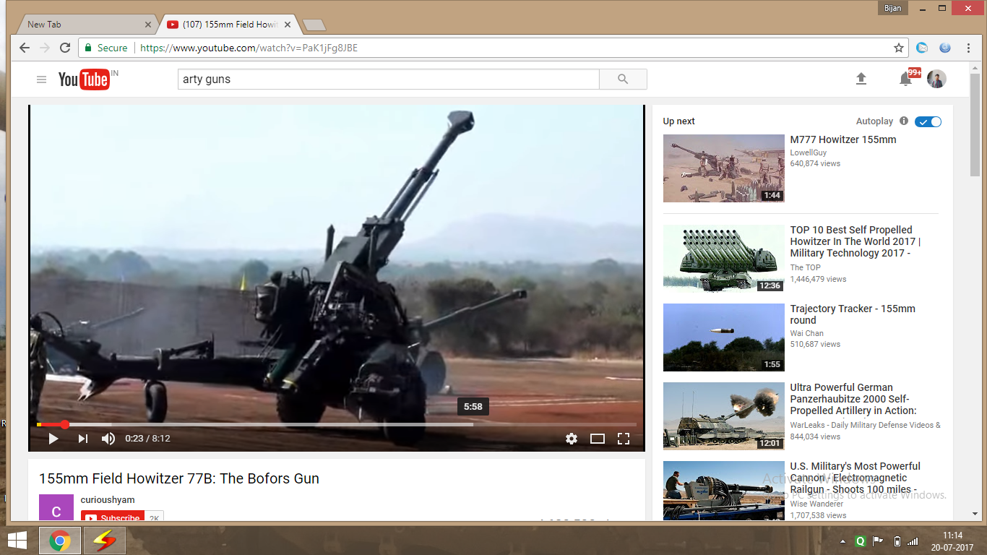
ARTY SHOOT

Slide 45


